Slide 1
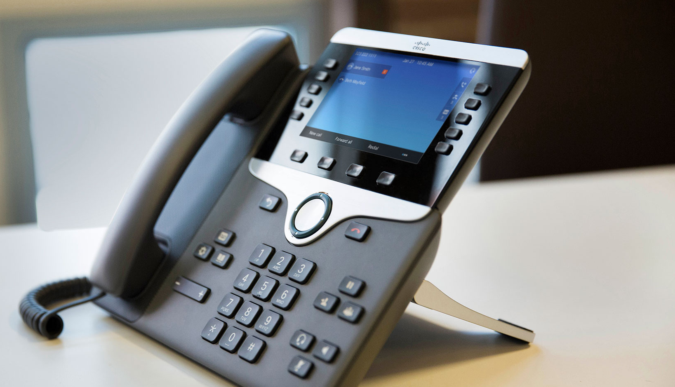
Cisco Multi platform
Phones (MPP)
Customer Support Training
May 2019
Product Development

Slide 2
Goals
For you to walk away from this session…
Why Cisco MPP Handsets?
Introduction to Handsets
Confluence Resources
Tier 1 Responsibilities
FAQs
Notes:
Here’s a quick outline on what I plan to cover today.

Slide 3
Why cisco mpp handsets
As a result of acquiring Broadsoft, Cisco released the MPP line with the open SIP protocol to now work on Evolve IP’s platform.
Standard DMS configured handsets
Interoperability with EXISTING LINE OF SUPPORTED handsetS
Alignment with cisco product suite
Notes:
Slide 3:
Please take a second to read these statements
Support for existing/NEW Cisco handsets that was normally exclusive to only Cisco Call manager. Opens up to Cloud based providers…
-(feel more comfortable)
-multi platform phones
-Cisco applications, more likely to be able to support it down the road.

Slide 4
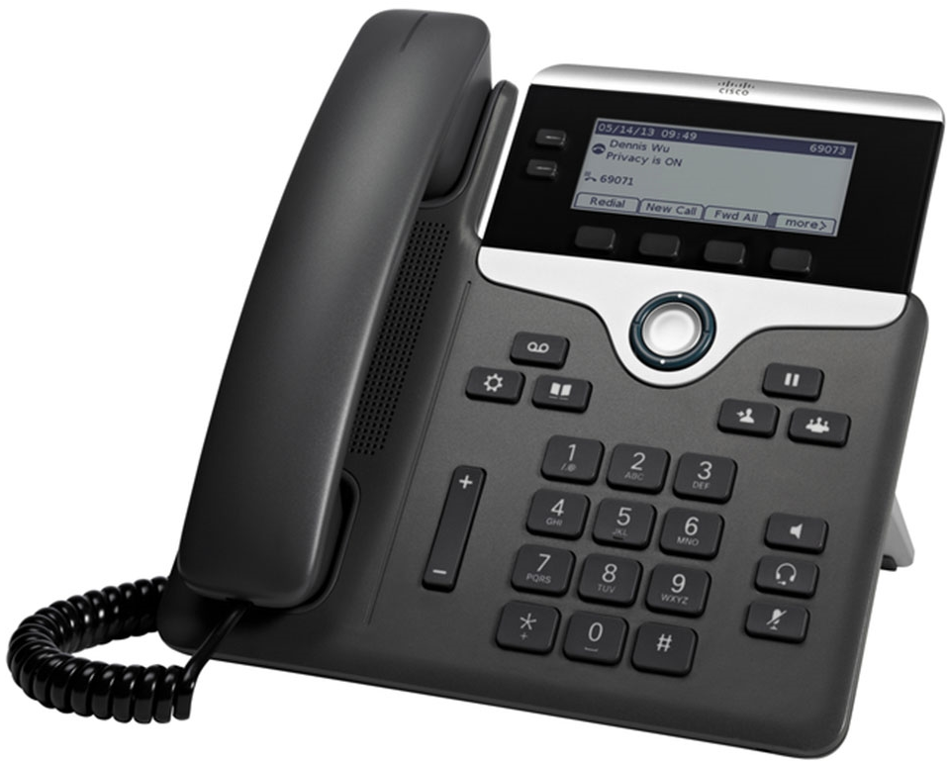
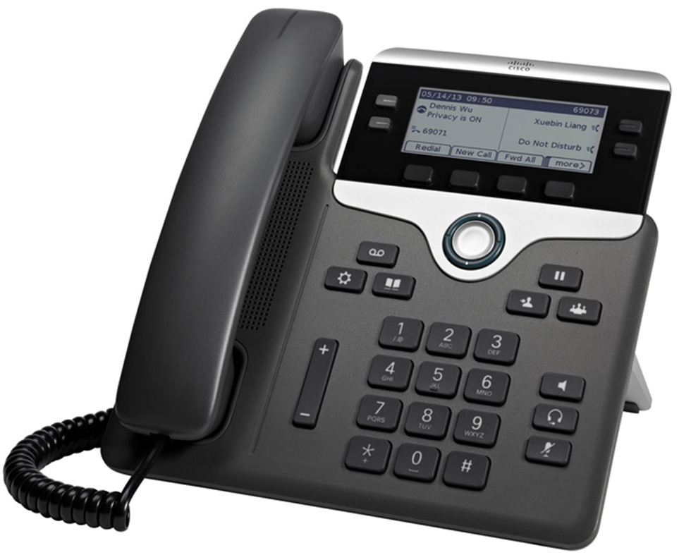
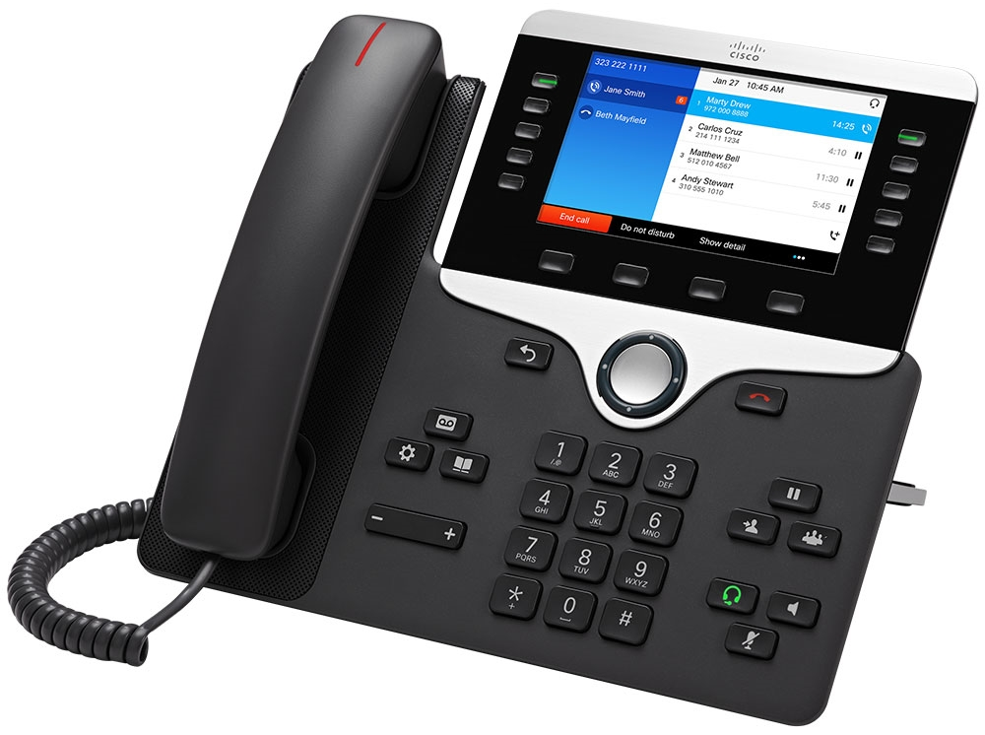
Included Evolved Office Seats
COMMON AREA USER
Handsets can be leased or purchased
3.5” monochrome screen (396x162)
2 lines
10/100 throughput
CISCO 7821
STANDARD, ENHANCED, UC USER
3.5” monochrome screen (396x162)
4 lines
10/100/1000 throughput
CISCO 7841
PREMIUM USER
5” WXGA Color screen (800x480)
5 lines
10/100/1000 throughput
CISCO 8841
Notes:
Slide 4:
by a show of hands... who isn't familiar? with current seat types
Offered to customers with the existing bundle packages.
Common/standard/premium comparison to Polycom and Yealink (VVX 300/T42S) (VVX400/T46S)
Handsets can be leased/purchased.
Offered to customers with the existing bundle packages.
Common/standard/premium comparison to Polycom and Yealink
Handsets can be leased/purchased.

Slide 5
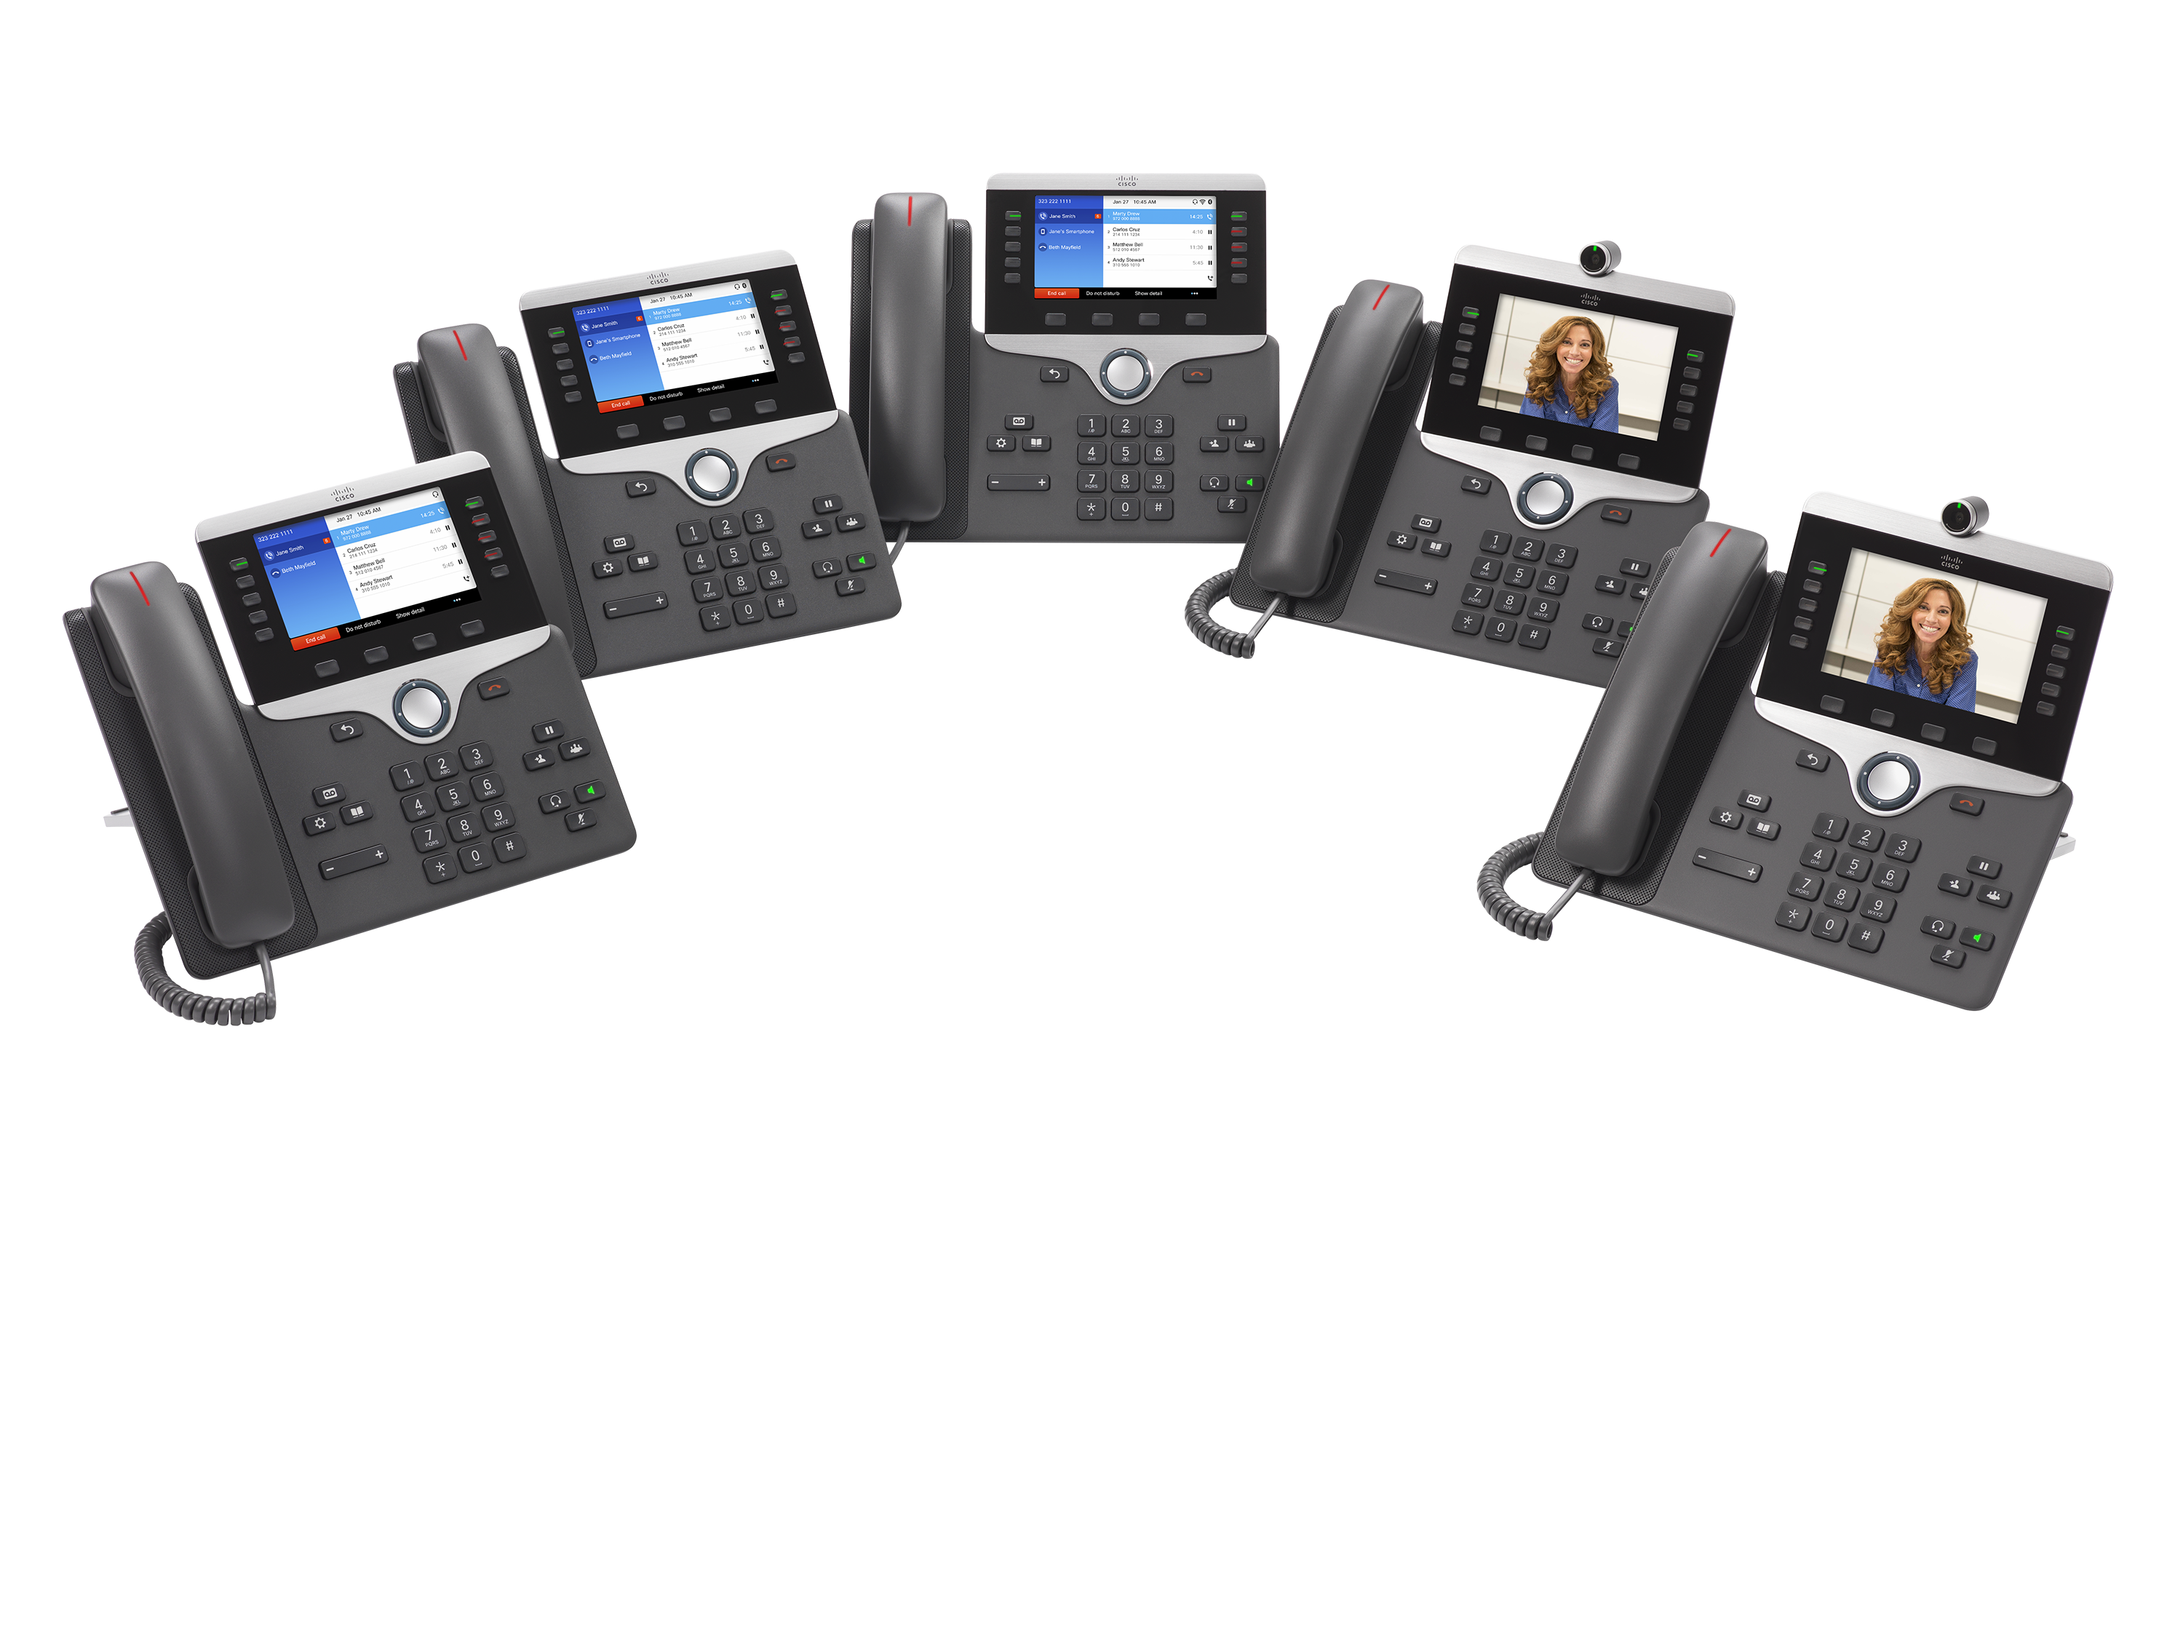
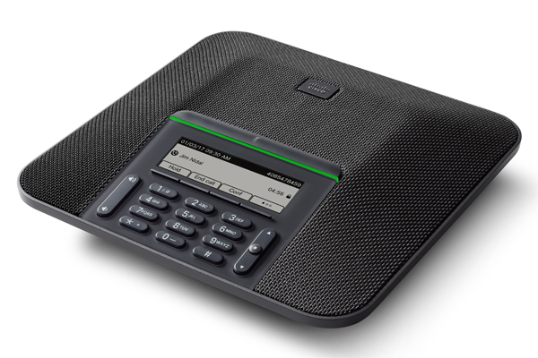
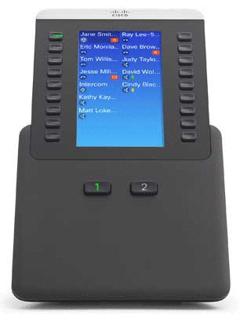
Upgrades (For Leased and Purchased Phones)
Cisco Model
7841
8841
8845 (video)
8861
8865 (video)
7832 (Conf. Phone)
Expansion Module
Notes:
-we will be launching with full support of all these models.

Slide 6
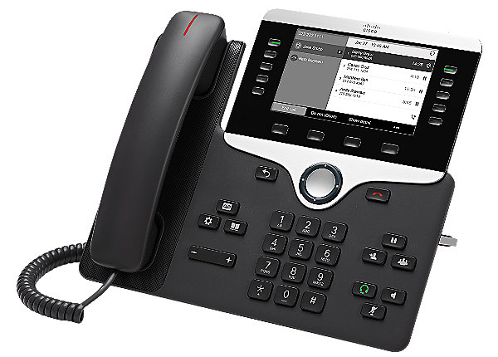
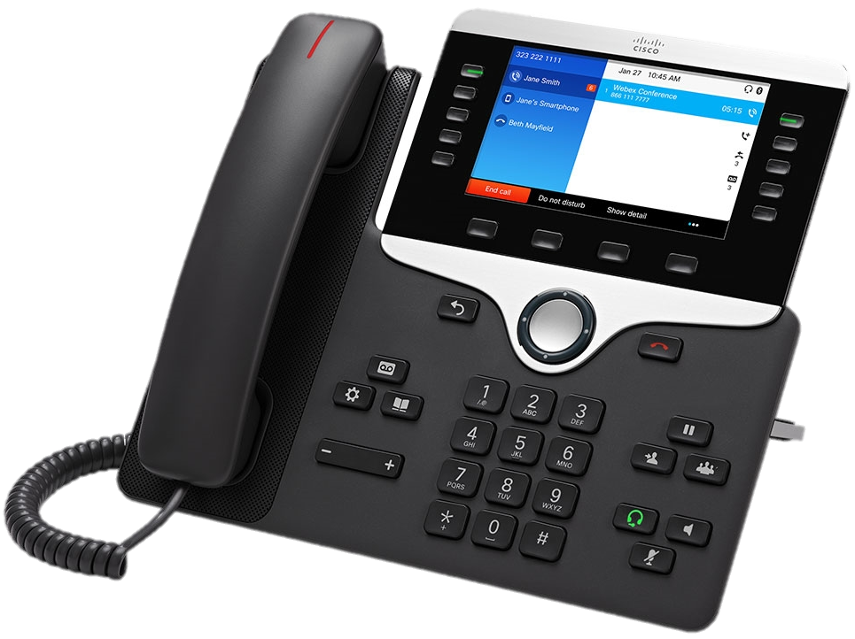
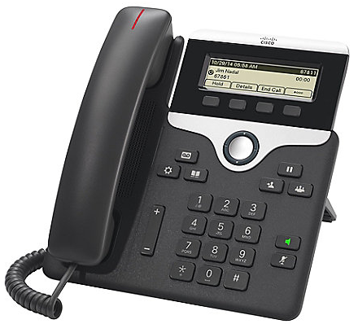
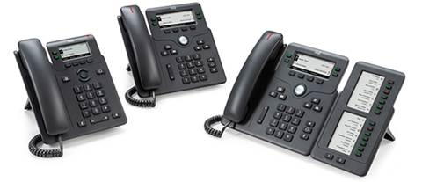
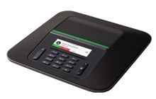
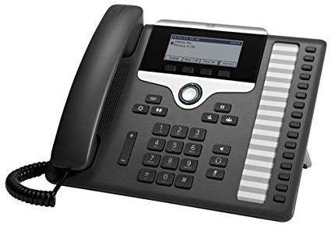
Support for additional Models
Operations SUPPORTS the configuration for the following models
but are NOT available for lease/ purchase
6800 Series | 7800 Series | 8800 Series
6841 | 7811 | 8811
6851 | 7861 | 8832
6800 (Keyset Expansion Module- KEM) |  | 8851
Notes:
The phones are SUPPORTED, even if we sell or lease them. The configurations are active in OSSmosis to be provisioned to the devices. Test phones will be available in the support lab for troubleshooting purposes…
in a perfect world... we would support just the 3 initial models.
-its easy to support as the layout to these devices is universal to all series. configs are specific to series as well.

Slide 7
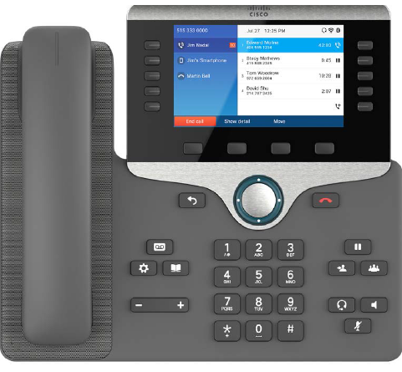
Cisco 8800 Series
5-inch WVGA
(800x 480 resolution)
Visual ring indicator
5 programmable line keys
Adjustable viewing angle
Replaceable bezel
Wideband audio handset
Soft keys
Wideband audio speakerphone
2-way navigation
and select key
Messaging, service,
and directory
Hold/resume, transfer,
and conference
Volume
Keypad
10/100/100 Ethernet
Audio path control
Notes:
Slide 7:
-here's a standard layout on one of the cisco handsets.
-keyword is standard as you’ll see a similar look/feel across all three series of phones

Slide 8
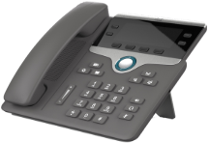
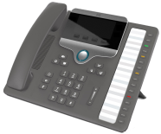
7800 Series- Key Features
 | 7821 | 7841 | 7861
Replaceable bezel
Screen | 396x162 mono (3.5”) | 396x162 mono (3.5”) | 396x162 mono (3.5”)
Ethernet switch | 10/100 | 10/100/1000 | 10/100
Programmable line keys | 2 | 4 | 16
Programmable soft keys | 4 | 4 | 4
Headset port
EHH support (AUX)
Full-duplex speakerphone
Wideband audio
POE class | 1 | 1 | 1
Protocols | SIP | SIP | SIP
SOLD & SUPPORTED
ONLY SUPPORTED
Notes:
Slide 8:
MPP 7821 - non gig phone

Slide 9
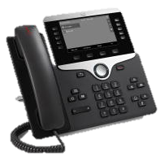
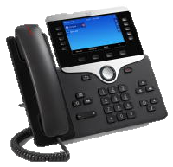
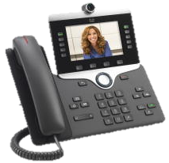


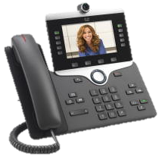
8800 Series- Key Features
 | 8811 | 8841 | 8845 | 8851 | 8861 | 8865
HD video (720p) | - | - |  | - | -
Integral switch | Gigabit | Gigabit | Gigabit | Gigabit | Gigabit | Gigabit
Programmable (line) keys | 5-10 | 5-10 | 5-10 | 5-10 | 5-10 | 5-10
Bluetooth/DECT | - | - | Bluetooth | Bluetooth | Bluetooth | Bluetooth
Cisco Intelligent Proximity | - | -
USB (physical ports) | - | - | - | 1 | 2 | 2
KEM | - | - | - | 2 | 3 | 3
Wi-Fi (802.11n) | - | - | - | -
Wall-mountable
SOLD & SUPPORTED
ONLY SUPPORTED
Notes:
Slide 9:
Bluetooth/Wi-Fi
-considerations for QOS
-Cisco proximity is an application that interacts with the phones via smartphone app
The guides/articles in confluence provide a quick reference to know the minor differences for ease of troubleshooting. i.e. 45/65 are video phones.

Slide 10
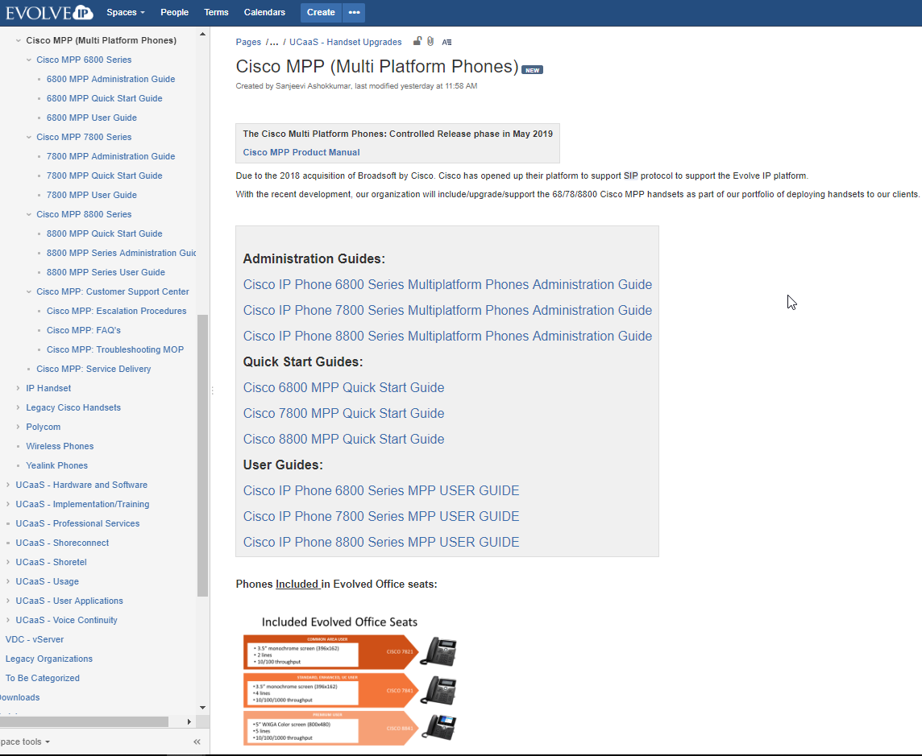
Cisco MPP and confluence
Cisco MPP Ops landing page: https://confluence.evolveip.net/pages/viewpage.action?pageId=39795005
6800/7800/8800 series pages:
  Handset buttons/features/connections
  Administration Guides (EIP only)
  Quick Start Guide and User Guide (Customer Facing)
Notes:
Leads into 68/78/8800 series pages: overview of device hardware and phone connections (screenshot of landing page)
Each series pages splits up into guides
Support to Provide the guides specific to each series that will help end users bring the phone on the network and register to Evolve IP’s platform.
Administration Guides (EIP only)
Quick Start Guide and User Guide (Customer Facing)

Slide 11
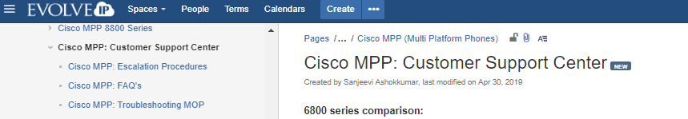
Confluence resources for tier 1
Cisco MPP- Customer Support Center: https://confluence.evolveip.net/display/EIKB/Cisco+MPP%3A+Customer+Support+Center
  Series comparison and feature differentiators
  Basic Troubleshooting MOP
  FAQ’s
  Escalation Procedures
Notes:
Troubleshooting questions that Support will encounter once the product goes LIVE.
Q/A’s on most common concerns reported
Quick Resolution on common P4 requests: info requests, functionality, series specific features
Use cases in where tickets need to be escalated to Tier 2 for review
For ex. ACD, Custom Tags, DMS config changes, and so on.

Slide 12
Troubleshooting decision tree
RESOURCES AVAILABLE?
ICD Search to Confluence
Manually search KB
REPORTED ISSUE
Open ICD Incident
Specify Summary/
Service Type/
Class Description
Troubleshooting and/or
Resolution
YES
Documentation Unavailable
UPDATE CLIENT (SLA)
NO
Review with Support Team
(Team Leads, Tier 2, CSC Management)
Notify BOSS Team
(Missing Class/MOP Description)
Create Class and MOP (product development)
Notes:
Slide 12:
-ask a general question P1 vs. P3 -Illustrate the scenario...talk thru the scenario
-FEEDBACK LOOP across multiple Functional areas and teams to reach resolution.

Slide 13
Frequently asked questions
How to set VLAN for Remote users?
  A: Cisco MPP Troubleshooting MOP
    Applications (Gear Icon) -> Network Configuration -> Ethernet Configuration -> Vlan & Vlan Id -> Save (no reboot required)
What about: Custom Line Labels/Time Zone Assignments/ACD Keys/BLF/SCA’s/Open Seating?
  A: Managed in OSSmosis 5
How can I replace a customer handset?
  A: Once troubleshooting is exhausted, go to the Cisco MPP landing page check that the phone model was leased or purchased from Evolve IP before delegating to Asset.
How about replacing or ordering a “Supported Handset?”
  A: We do not supply the 6800 series and some 78/8800 series phones. Detail the models that are supplied by EIP. If requested for additional details, delegate the request to their CTA.
How to register a Cisco MPP behind a Managed Network Setup (Edgemarc)?
  A: Cisco MPP are based off DMS configurations. The EW is set to point to the Pconf server address.
  Ensure that the user seat and device profile is assigned for the handset to provision and register.
How do I bill the customer on a new seat setup?
  Follow support process (P4) with delegating ticket to Billing if a new seat is provisioned for a leased or purchased device. Please include details on make/model. For ex. Cisco MPP 7841
What about Third Party Headset Compatibility?
  A: Cisco MPP Troubleshooting MOP has a matrix on headset compatibility for the MPP series.

Slide 14
Where do I go for cisco MPP content?
Evolve IP Website Updated:
  All Cisco MPP Phones listed now. Note we are displaying all phones- Supplied and Supported.
  https://www.evolveip.net/phone-systems/phone-options
Product Manual
  https://confluence.evolveip.net/pages/viewpage.action?pageId=44467253
Service Delivery
  https://confluence.evolveip.net/display/EIKB/Cisco+MPP%3A+Service+Delivery

Slide 15
Timeline
Current Product Phase: INTERNAL BETA
OSSmosis Automation & Provisioning: May 2019
Customer Support: June 2019
Notes:
Proactive training for support before the 1st implementation… shouldn’t take calls prior to this point.
Slide 15/16:
-Ending statement
-a lot of information. cisco is going to be part of our product suite...
-its important for the first line of defense be well equipped to handle these questions and concerns reported.

Slide 16
QUESTIONS?

